Slide 1
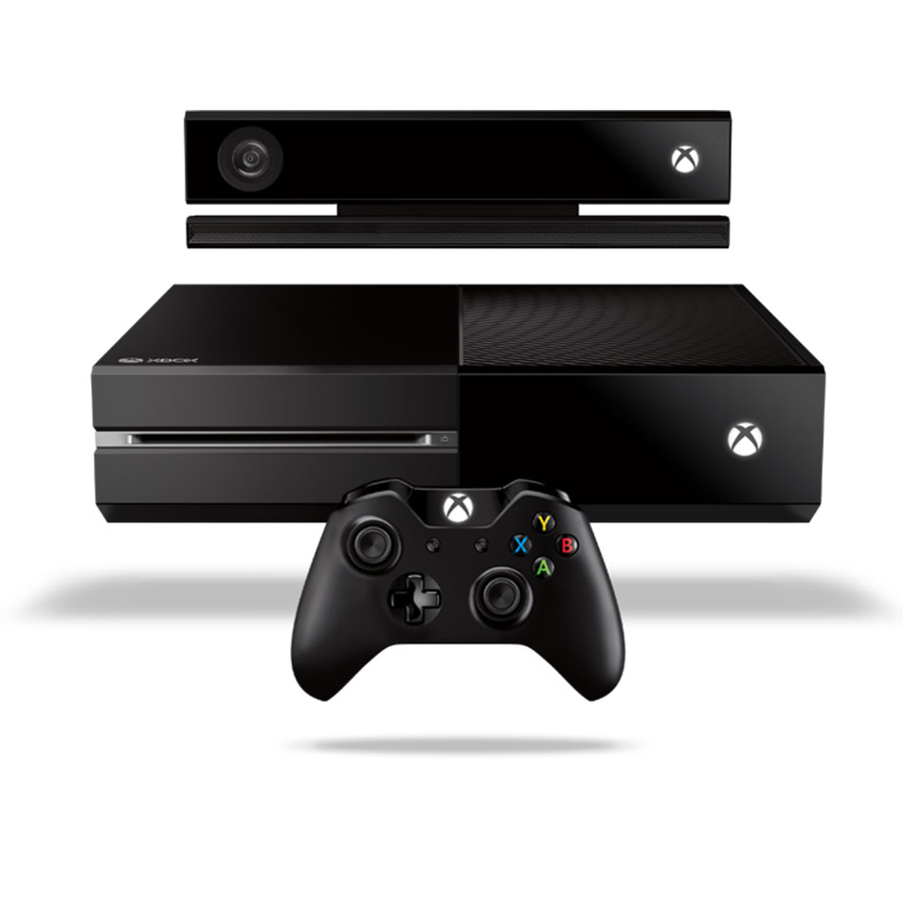
Xbox One
Pearson Radu

Slide 2
All-in-one Entertainment Box
The Xbox One comes in two packages (W and W/O Kinect 2.0)
Easily interact with the new more responsive Kinect 2.0
New sleek body design with the One design
Private game releases with the Xbox Gold membership
Allow your cable/satellite service to pass through the Xbox One
Plays Blu-Ray
Most advanced multiplayer
Notes:
Create an Xbox Avatar for all your Xbox Friends to see.
Talk to the Xbox One Kinect about what you want to do.
Gasp the new Xbox One Controller tightly, it has double the rumblers.

Slide 3
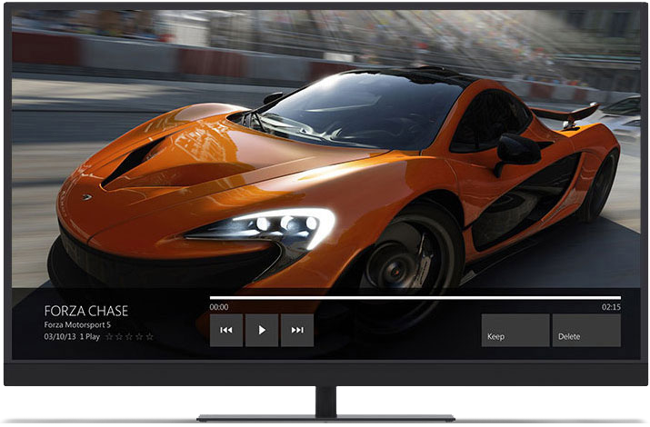
Gaming Experience
Largest cloud infrastructures dedicated to multiplayer games
Smart Match algorithms to fit your style with people like you
Next generation of Xbox Achievements
In game DVR (Digital Video Recording)
Broadcast while you play

Slide 4
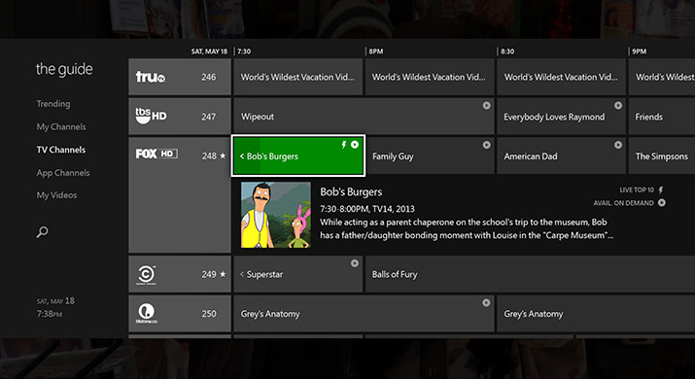
the guide
Xbox One’s TV slide transforms your service providers guide into it’s own
With the Xbox One Kinect you can even tell your TV what to do
Ex. “Xbox volume up/down”
You can even Snap Apps while you watch shows or sports
“Xbox snap skype”

Slide 5
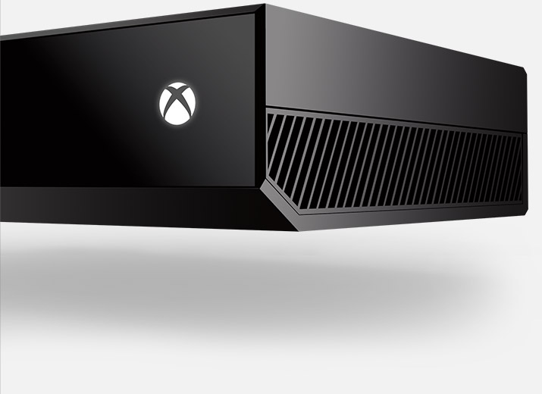
Specifications
An 8-core x86 processor allowing you to switch between games and apps
HDMI Pass-Thru for cable/satellite on your Xbox One
8GB or Ram for a rapid gaming experience
Gaming OS fused with Windows OS
Infrared Controller sensor to interact with Kinect
Hand gestures to control Kinect
Mobile device pairing
Notes:
Create your own avatar with the Xbox One for all your friends to see.
Chat with your Xbox One Kinect about what you want to do.
The redesigned Xbox One Controller now has double the rumblers,

Slide 6
Check it out for yourself!
http://www.xbox.com/en-CA/xbox-one/meet-xbox-one?xr=shellnav

